Slide 1

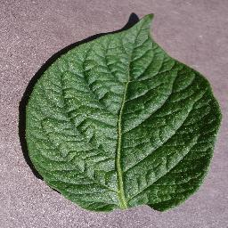
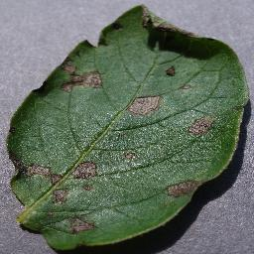
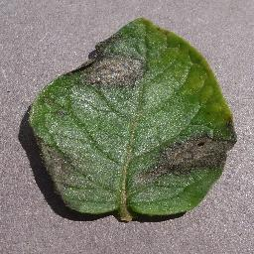
healthy
Early blight
Late blight
Potato plants are sensitive to various diseases, namely early blight caused by a fungus and late blight attributed to specific microorganisms. Detecting these diseases early and accurately is pivotal in implementing suitable treatments, thereby reducing waste and preventing economic losses for farmers.

Slide 2

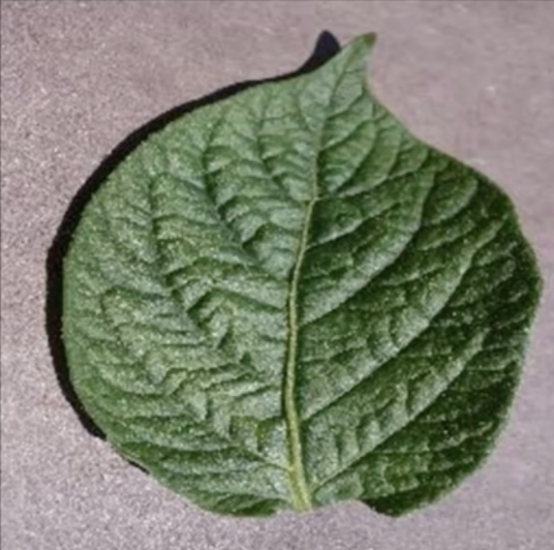
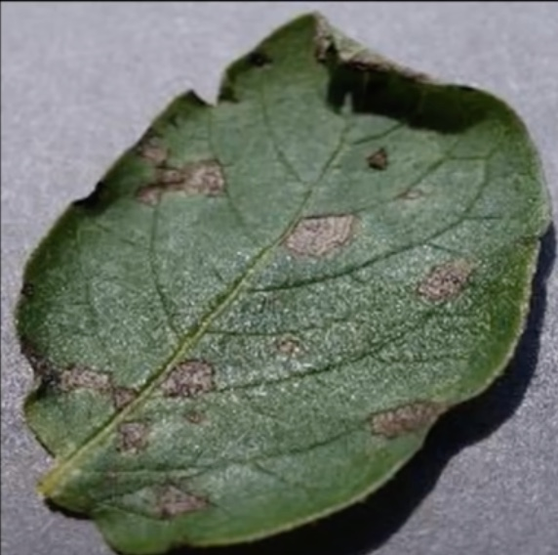

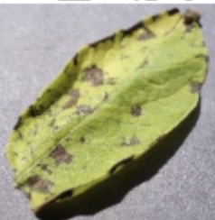
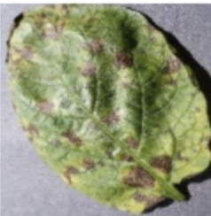

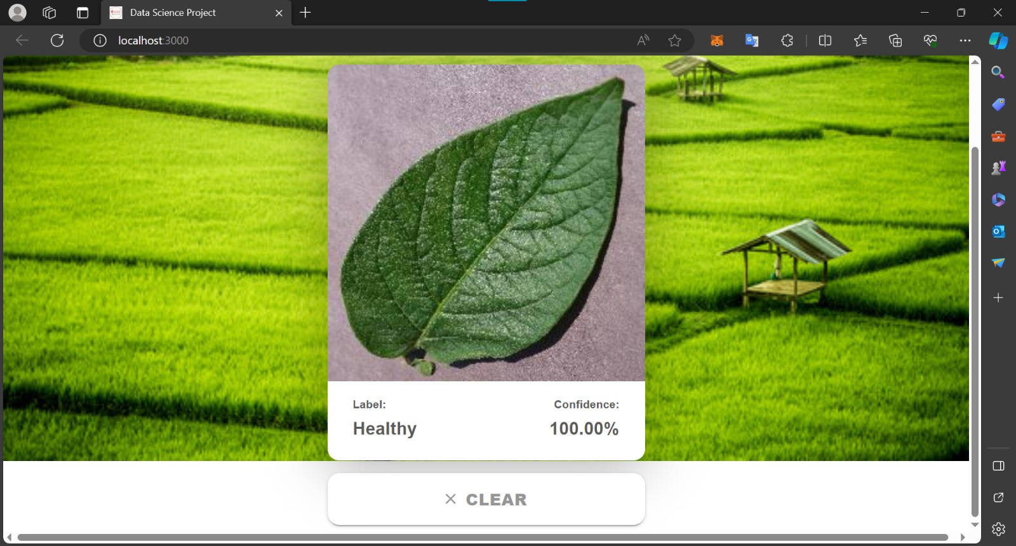
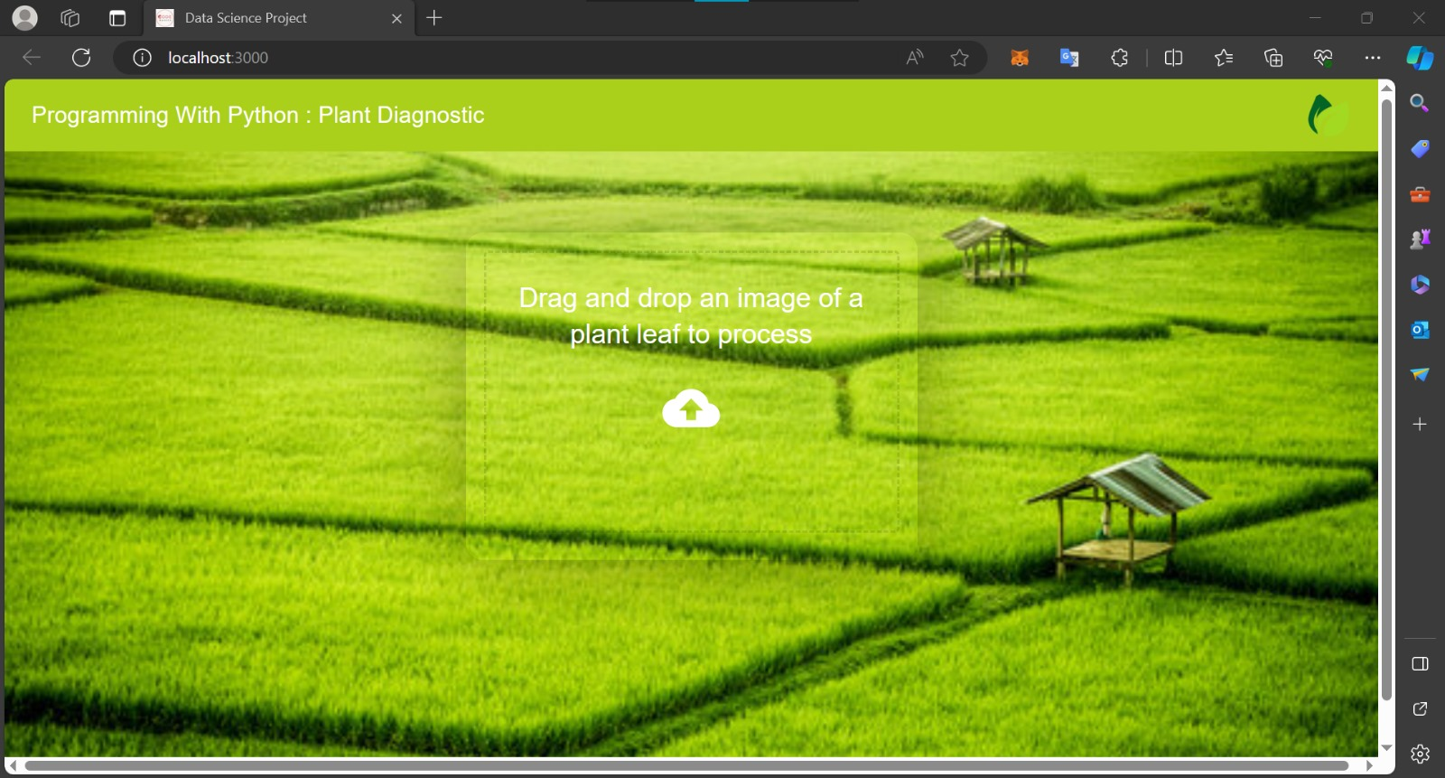
Data Cleaning & Preprocessing
Model Building
Tf dataset
CNN
Data augmentation
http://localhost:8000
React JS

Slide 3



Model Building
CNN (Convolutional
Neural Network)
Data augmentation
Tf dataset
Backend Server
Model Optimization
Frontend
&
Deployment
React JS

Slide 4
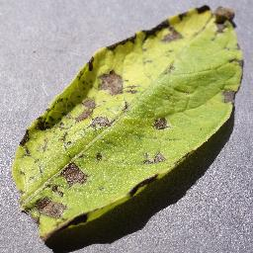
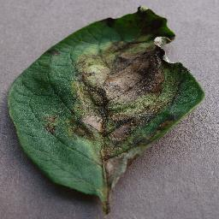
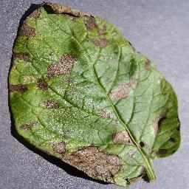
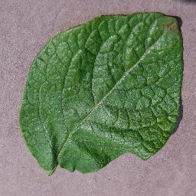
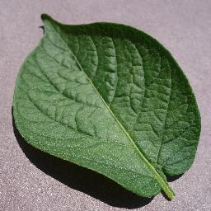
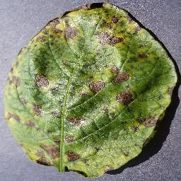
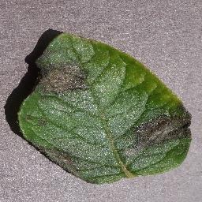
RAM
Tf_dataset
1ooo image batch
[[34,70,178,110…],[189,27,145,63…],[40,70,67,189…]] | healthy
[[56,44,213,111…],[57,48,11,17…],[12,210,123,244…]] | healthy
[[210,19,78,131…],[37,87,123,173…],[99,44,55,188…]] | Early_blight
[[80,78,214,124…],[73,42,22,19…],[86,236,173,844…]] | late_blight
Hard disk
Tf_datatest=tf_datatest.filtre(filter_func)
[[34,70,178,110…],[189,27,145,63…],[40,70,67,189…]] | healthy
[[210,19,78,131…],[37,87,123,173…],[99,44,55,188…]] | Early healthy
[[80,78,214,124…],[73,42,22,19…],[86,236,173,844…]] | Late_blight
tf_dataset = tf_dataset.map (lambda x: ×/255)
[[10.13,0.27,0.69,0.43],[0.74,0.1,0.56,0.24],[0.15,0.27,0.26,0.74]] | healthy
[[0.82,0.07,0.3,0.5], [0.14,0.34,0.48,0.67],[0.38,0.17,0.21,0.73]] | Early healthy
[[11.85,0.17,0.6,0.8], [0.94,0.4,0.65,0.27],[0.78,0.97,0.41,0.34]] | Late_blight
10 million images

Slide 5
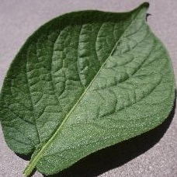
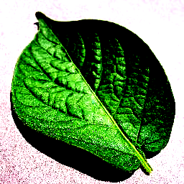
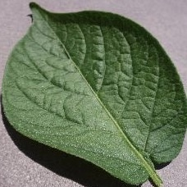
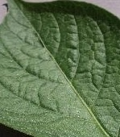
Time(s)
Read - CPU
Batch - 1
Batch - 2
Batch - 3
Train - GPU
Batch - 1
Batch - 2
Batch - 3
3 sec
6 sec
9 sec
12 sec
Tf.data.Dataset.prefetch(1)
Horizontal Flip
contrast
Original image
Rotation
Zoom

Slide 6
Color,lesion,shape etc
Bottom part,upper part
3
flatten
Is the
Leaf helathy?
Convolution + ReLu
Pooling
Pooling
Convolution + ReLu
7

